Slide 1
Chapter 26
Progress and Its Discontents: Post-Impressionism, Symbolism, and Art Nouveau, 1880–1905

Slide 2
Learning Objectives
Describe the Modernity that emerged in the closing decades of the century, the many complex issues surrounding it, and the broad impact that Modernity had on avant-garde art.
Discuss the different ways American and European modern architecture of this period from 1880 to 1906 both broke away from the previously dominant revival styles and also was spiritual, thus sharing some of the concerns of the Postmodernists and Symbolists.
Identify the qualities that the Post-Impressionists and Symbolists took from the Impressionists, and the qualities they abandoned or rejected.
Explain why fine art photographers were so preoccupied with establishing their medium as a major art form, and how their work reflects the same issues found in painting, sculpture, and architecture of the late nineteenth/early twentieth century.

Slide 3
Modern Life (1)
The work of Edgar Degas often depicted observances of rehearsals and performance of ballet.
The Rehearsal on Stage is not a factual record, but a contrivance viewed from the angled perspective of an opera box.
Dancers stretch, look bored or exhausted, and are watched over by several "protectors.”
Degas's later images include intimate scenes of bathing women.
The Tub is rendered from an elevated, domineering vantage point, evidenced by the tipped-up table with a still life of objects associated with bathing.

Slide 4
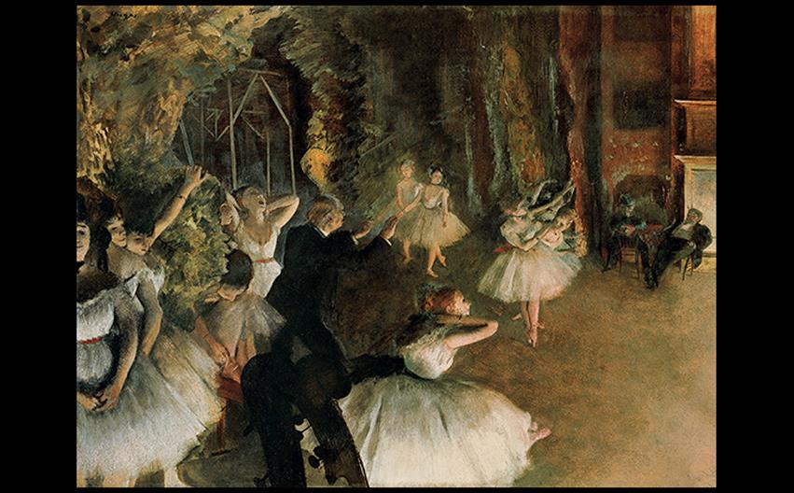
Edgar Degas THE REHEARSAL ON STAGE c. 1874. Pastel over brush-and-ink drawing on thin, cream-colored wove paper, laid on bristol board, mounted on canvas, 21-3/8" × 28-3/4" (54.3 × 73 cm). Metropolitan Museum of Art, New York. Bequest of Mrs. H. O. Havemeyer Collection, Gift of Horace Havemeyer, 1929 (29.160.26). © 2016. Image copyright The Metropolitan Museum of Art/Art Resource, NY/Scala, Florence.
Notes:
Edgar Degas THE REHEARSAL ON STAGE c. 1874. Pastel over brush-and-ink drawing on thin, cream-colored wove paper, laid on bristol board, mounted on canvas, 21-3/8" × 28-3/4" (54.3 × 73 cm). Metropolitan Museum of Art, New York. Bequest of Mrs. H. O. Havemeyer Collection, Gift of Horace Havemeyer, 1929 (29.160.26). © 2016. Image copyright The Metropolitan Museum of Art/Art Resource, NY/Scala, Florence.

Slide 5
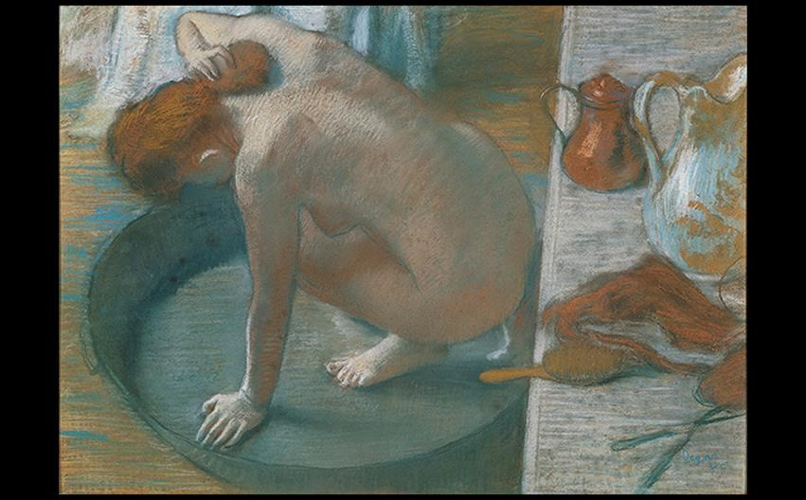
Edgar Degas THE TUB 1886. Pastel on cardboard, 23-5/8" × 32-5/8" (60 × 83 cm). Musée d'Orsay, Paris. Photo © RMN-Grand Palais (musée d'Orsay)/Hervé Lewandowski.
Notes:
Edgar Degas THE TUB 1886. Pastel on cardboard, 23-5/8" × 32-5/8" (60 × 83 cm). Musée d'Orsay, Paris. Photo © RMN-Grand Palais (musée d'Orsay)/Hervé Lewandowski.

Slide 6
Modern Life (2)
Mary Cassatt was an American expatriate living in Paris who befriended Degas.
Her work sought to counteract the clichéd conceptions of the domestic and social life of bourgeois women.
Mother and Child features contrast between loosely painted clothing and solidly modeled forms of faces and hands.

Slide 7
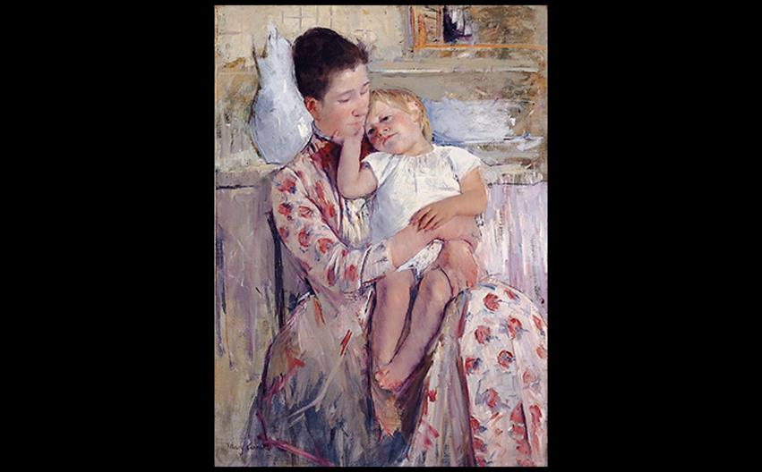
Mary Cassatt MOTHER AND CHILD c. 1890. Oil on canvas, 35-1/2" × 25-3/8" (90.2 × 64.5 cm). Wichita Art Museum, Kansas.
Notes:
Mary Cassatt MOTHER AND CHILD c. 1890. Oil on canvas, 35-1/2" × 25-3/8" (90.2 × 64.5 cm). Wichita Art Museum, Kansas.

Slide 8
Modern Life (4 of 4)
Gustave Caillebotte expressed his fascination for the regularized, radiating streets of Paris in Paris Street, Rainy Day.
This asymmetrical composition and tipped perspective highlights the streets as the subject amidst bustling, anonymous crowds.

Slide 9
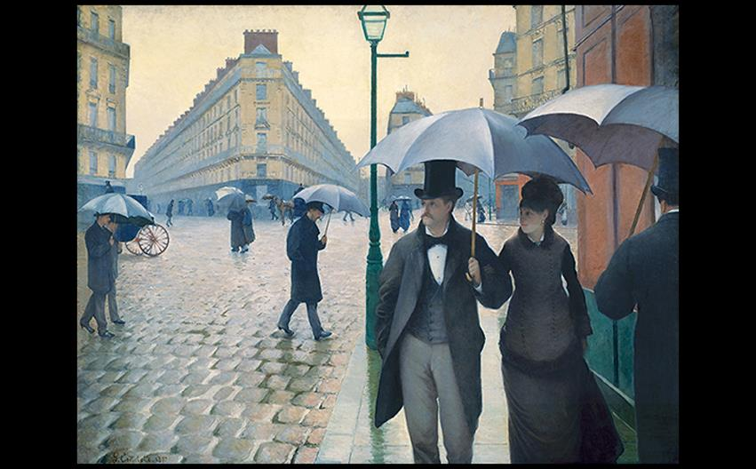
Gustave Caillebotte PARIS STREET, RAINY DAY 1877. Oil on canvas, 83-1/2" × 108-3/4" (212.2 × 276.2 cm). The Art Institute of Chicago. Charles H. and Mary F.S. Worcester Collection (1964.336). Photo © The Art Institute of Chicago.
Notes:
Gustave Caillebotte PARIS STREET, RAINY DAY 1877. Oil on canvas, 83-1/2" × 108-3/4" (212.2 × 276.2 cm). The Art Institute of Chicago. Charles H. and Mary F.S. Worcester Collection (1964.336). Photo © The Art Institute of Chicago.

Slide 10
Japonisme (1 of 2)
After the forced reopening of the borders of Japan in 1853, artworks began to be distributed through Paris.
Soon, obsession with collecting Japanese objects and art was termed Japonisme.
Individual Japanese artists worked purely on aesthetic conception rather than Renaissance rules.

Slide 11
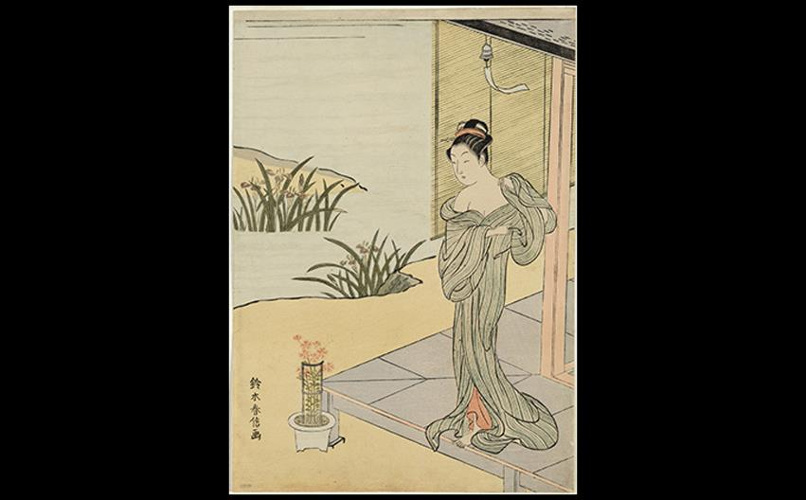
Suzuki Harunobu YOUNG WOMAN LOOKING AT A POT OF PINKS c. 1767. Woodblock print, 10-5⁄8" × 7-1⁄2″ (27 × 19.2 cm). The Cleveland Museum of Art. Bridgeman Images.
Notes:
Suzuki Harunobu YOUNG WOMAN LOOKING AT A POT OF PINKS c. 1767. Woodblock print, 10-5⁄8 × 7-1⁄2″ (27 × 19.2 cm). The Cleveland Museum of Art. Bridgeman Images.

Slide 12
Japonisme (2 of 2)
Cassatt directly emulated the ukiyo-e style, which she had seen at a 1890 exhibition of Japanese woodblock prints.
She created ten prints using aquatint and drypoint, and they featured cropped, asymmetrical compositions that would have been seen in Japanese prints.

Slide 13
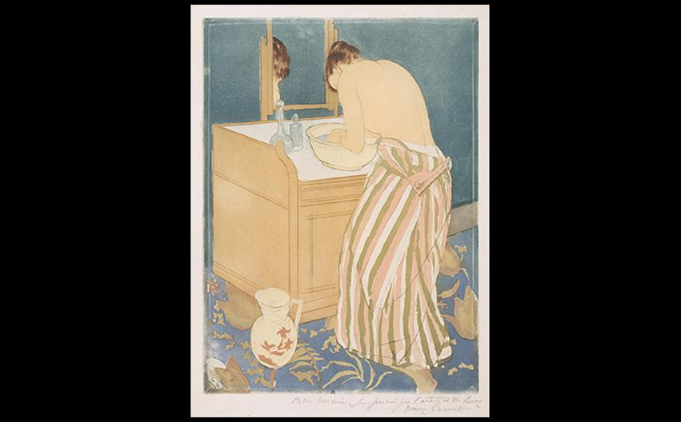
Mary Cassatt WOMAN BATHING 1890–1891. Color drypoint and aquatint, 16-5⁄8" × 12″ (42.3 × 30.5 cm). National Gallery of Art, Washington, D.C., Chester Dale Collection (1963.10.253) Image courtesy the National Gallery of Art, Washington
Notes:
Mary Cassatt WOMAN BATHING 1890–1891. Color drypoint and aquatint, 16-5⁄8" × 12″ (42.3 × 30.5 cm). National Gallery of Art, Washington, D.C., Chester Dale Collection (1963.10.253) Image courtesy the National Gallery of Art, Washington

Slide 14
The Late Nineteenth Century
Artists worked to developed new visual languages for their messages.
French Post-Impressionists interpreted art as an expression of the imagination.
Symbolist artists found a similar retreat in the imagination.
Art Nouveau artists rejected rational order in favor of whimsical, writhing designs.

Slide 15
Post-Impressionism (1 of 5)
Critic Roger Fry used this term as a description for a group of artists whose work was not unified, but shared the founding principles of Impressionism from which to adapt.

Slide 16
Post-Impressionism (2 of 5)
Seurat
Georges Seurat (1859–1891) devoted his life to "correcting" shallow aspects of Impressionism.
He juxtaposed small strokes of pure, unblended color, creating pointilism and the effect of complementary color proposed by Chevreul.
Sunday Afternoon... was painted with 11 colors in three values.

Slide 17
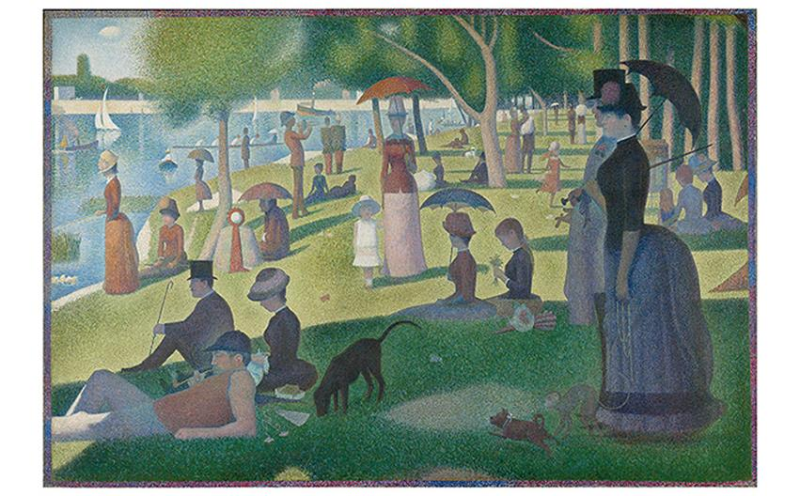
Georges Seurat A SUNDAY AFTERNOON ON THE ISLAND OF LA GRANDE JATTE 1884–1886. Oil on canvas, 6'9-1/2" × 10'1-1/4" (207 × 308 cm). The Art Institute of Chicago. Helen Birch Bartlett Memorial Collection (1926.22). Photo © The Art Institute of Chicago.
Notes:
Georges Seurat A SUNDAY AFTERNOON ON THE ISLAND OF LA GRANDE JATTE 1884–1886. Oil on canvas, 6'9-1/2" × 10'1-1/4" (207 × 308 cm). The Art Institute of Chicago. Helen Birch Bartlett Memorial Collection (1926.22). Photo © The Art Institute of Chicago.

Slide 18
Post-Impressionism (3 of 5)
Van Gogh and Gauguin
One of the most famous Post-Impressionists, Van Gogh was a socialist who believed that modern life alienated people from both one another and themselves.
His contributions to art would lead to the later emergence of Expressionism, art that exaggerates aspects of form to evoke subjective emotion.

Slide 19
Post-Impressionism (4 of 5)
Van Gogh and Gauguin
The artist adapted Seurat's technique, painting in free, multidirectional impasto lines.
The Starry Night explores his contemplation of life and death with psychological, energetic intensity.

Slide 20
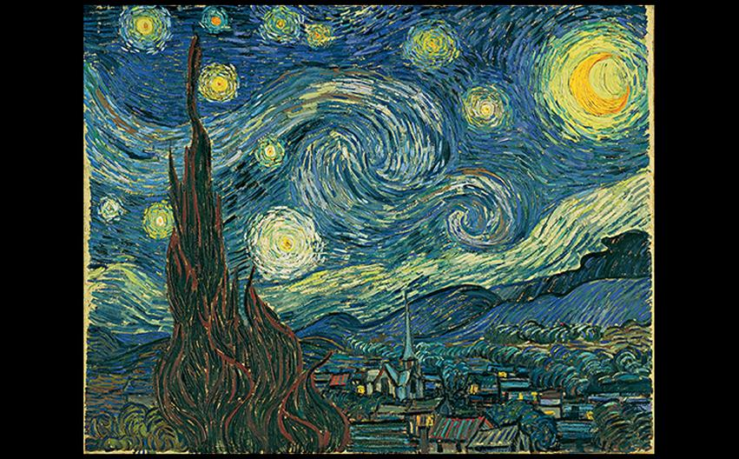
Vincent van Gogh THE STARRY NIGHT 1889. Oil on canvas, 28-3/4 × 36-1/4" (73 × 93 cm). Museum of Modern Art, New York. Acquired through the Lillie P. Bliss Bequest (472.1941). © 2016. Digital Image, The Museum of Modern Art, New York/Scala, Florence.
Notes:
Vincent van Gogh THE STARRY NIGHT 1889. Oil on canvas, 28-3/4 × 36-1/4" (73 × 93 cm). Museum of Modern Art, New York. Acquired through the Lillie P. Bliss Bequest (472.1941). © 2016. Digital Image, The Museum of Modern Art, New York/Scala, Florence.

Slide 21
Post-Impressionism (5 of 5)
Van Gogh and Gauguin
Paul Gauguin created a style he called synthetism, which mixed the observation of a subject with the artist's feelings on that subject.
Mahana no Atua, painted during his brief return from travels to the South Pacific, depicts an Edenic ideal closer to his imagination than the colonized cultural reality.

Slide 22
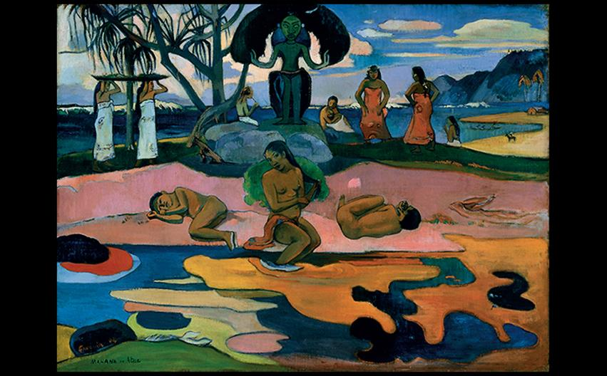
A CLOSER LOOK: Mahana no atua (Day of the God) by Paul Gauguin 1894. Oil on canvas. 27-3/8" × 35-5/8" (69.5 × 90.5 cm). The Art Institute of Chicago. Helen Birch Bartlett Memorial Collection (1926.198). Photo © The Art Institute of Chicago.
Notes:
A CLOSER LOOK: Mahana no atua (Day of the God) by Paul Gauguin 1894. Oil on canvas. 27-3/8" × 35-5/8" (69.5 × 90.5 cm). The Art Institute of Chicago. Helen Birch Bartlett Memorial Collection (1926.198). Photo © The Art Institute of Chicago.

Slide 23
Symbolism (1 of 3)
This movement addressed the fears, desires, and impulses of the human mind.
Artists rejected the value of rationalism and utilized strange and ambiguous subject matter in stylized forms.
Paintings paralleled a similar movement among poets and writers.

Slide 24
Symbolism (2 of 3)
Moreau
Gustave Moreau rendered The Apparition with the macabre head of John the Baptist dripping blood as it hovers in midair.
A seductive Salomé drips with decadence in the foreground, symbolizing her role as femme fatale who uses her sensuality to destroy a male victim.

Slide 25
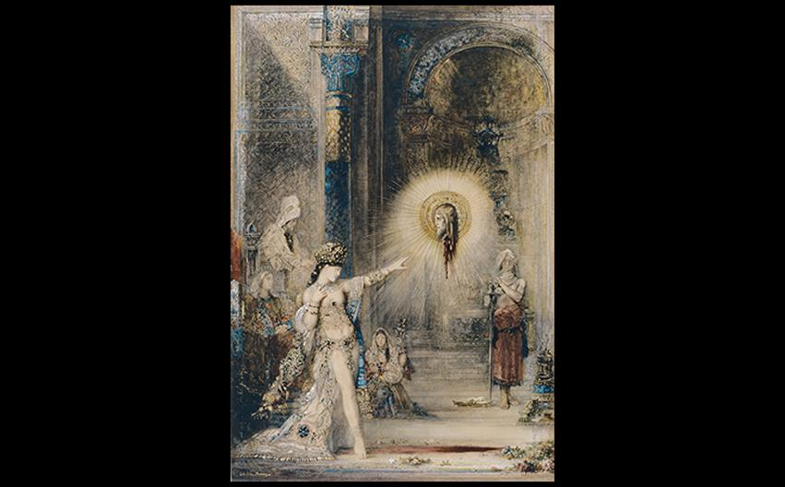
Gustave Moreau THE APPARITION 1874–1876. Watercolor on paper, 41-5/16" × 28-3/16" (106 × 72.2 cm). Musée du Louvre, Paris. Photo © RMN-Grand Palais (musée d'Orsay)/Jean-Gilles Berizzi.
Notes:
Gustave Moreau THE APPARITION 1874–1876. Watercolor on paper, 41-5/16" × 28-3/16" (106 × 72.2 cm). Musée du Louvre, Paris. Photo © RMN-Grand Palais (musée d'Orsay)/Jean-Gilles Berizzi. [Fig.

Slide 26
Symbolism (3 of 3)
Munch
Edvard Munch's The Scream depicts a feeling of overwhelming anxiety culminating in a primal scream.
Ensor
A group of agitated people in the foreground of The Intrigue are rendered with masks on their faces, giving them a disturbing and menacing quality.

Slide 27
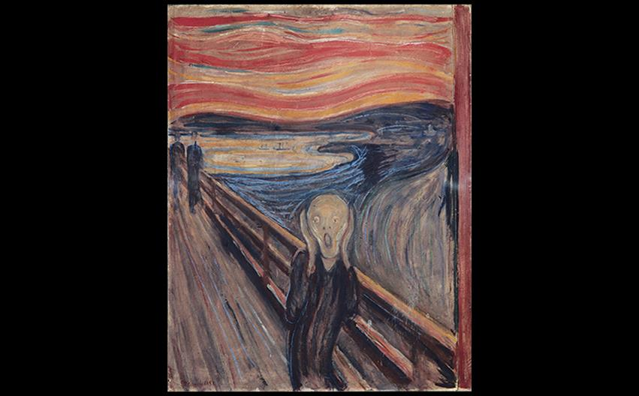
Edvard Munch THE SCREAM 1893. Tempera and oil on unprimed canvas, 33 × 26" (83.5 × 66 cm). Munch Museum, Oslo. © 2016 Artists Rights Society (ARS), New York. Nasjonalgalleriet, Oslo, Norway/Bridgeman Images.
Notes:
Edvard Munch THE SCREAM 1893. Tempera and oil on unprimed canvas, 33 × 26" (83.5 × 66 cm). Munch Museum, Oslo. © 2016 Artists Rights Society (ARS), New York. Nasjonalgalleriet, Oslo, Norway/Bridgeman Images.

Slide 28
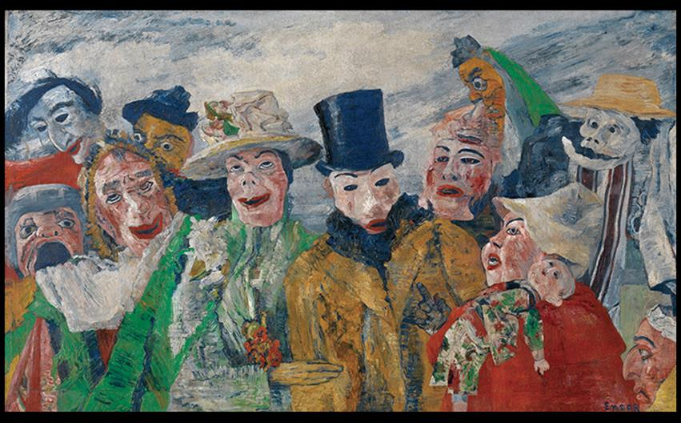
James Ensor THE INTRIGUE 1890. Oil on canvas, 35-1/2" × 59" (90.3 × 150 cm). Koninklijk Museum voor Schone Kunsten, Antwerp. © Lukas - Art in Flanders VZW/Photo: Hugo Maertens/Bridgeman Images.
Notes:
James Ensor THE INTRIGUE 1890. Oil on canvas, 35-1/2" × 59" (90.3 × 150 cm). Koninklijk Museum voor Schone Kunsten, Antwerp. © Lukas - Art in Flanders VZW/Photo: Hugo Maertens/Bridgeman Images.

Slide 29
French Sculpture (1 of 2)
Auguste Rodin (1840–1917) failed to get into the École des Beaux-Arts, leading him to assist other sculptors.
He developed a vigorously modeled style, exhibited in the Burghers of Calais monument commissioned to commemorate an event from the Hundred Years' War.
Critics in Calais were not please with the exaggerated expressions.

Slide 30
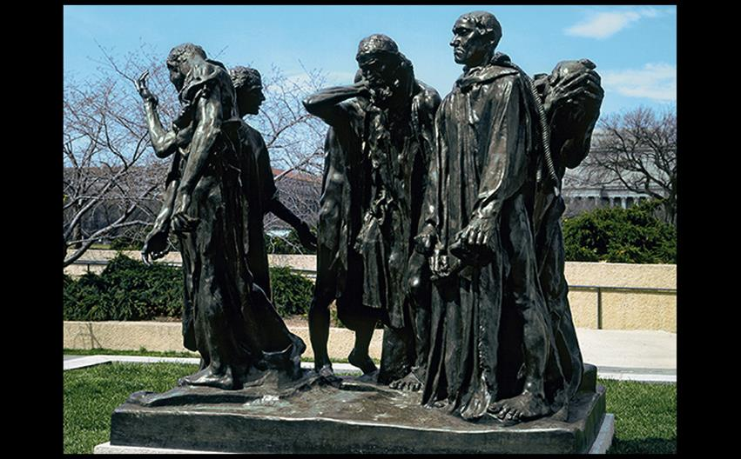
Auguste Rodin THE BURGHERS OF CALAIS 1884–1889. Bronze, 6'10-1/2" × 7'11" × 6'6" (2.1 × 2.4 × 2 m). Hirshhorn Museum and Sculpture Garden, Smithsonian Institution, Washington, DC. Gift of Joseph H. Hirshhorn, 1966 (66.4340).
Notes:
Auguste Rodin THE BURGHERS OF CALAIS 1884–1889. Bronze, 6'10-1/2" × 7'11" × 6'6" (2.1 × 2.4 × 2 m). Hirshhorn Museum and Sculpture Garden, Smithsonian Institution, Washington, DC. Gift of Joseph H. Hirshhorn, 1966 (66.4340).

Slide 31
French Sculpture (2 of 2)
Camille Claudel, assistant and later mistress to Rodin, was herself an accomplished sculptor.
The Waltz is a celebrated sculpture of a dancing couple in the nude.
After a government inspector called the nudity indecent, she added a swirling cloth to the woman's lower body.
Sinuous poses recall fluid lines of the Art Nouveau.

Slide 32
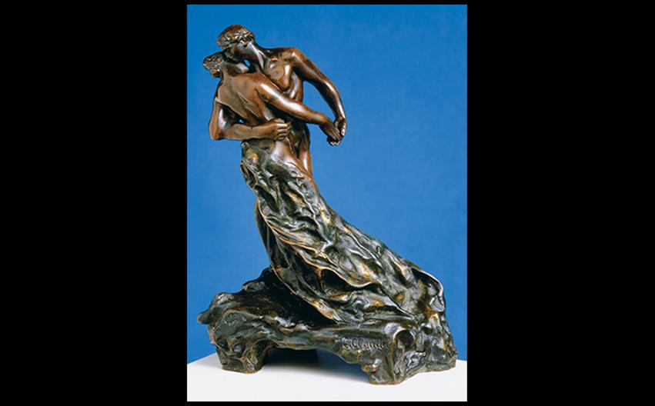
Camille Claudel THE WALTZ 1892–1905. Bronze, height 9-7/8" (25 cm). Neue Pinakothek, Munich. Photo © Blauel/Gnamm/ARTOTHEK.
Notes:
Camille Claudel THE WALTZ 1892–1905. Bronze, height 9-7/8" (25 cm). Neue Pinakothek, Munich. Photo © Blauel/Gnamm/ARTOTHEK.

Slide 33
Art Nouveau (1 of 5)
Literally "new art," the Art Nouveau movement rejected values of modern industrial society.
Rejecting the functional aesthetic in works such as the Eiffel Tower, artists and architects drew their inspiration from nature and delicate, graceful forms.

Slide 34
Art Nouveau (2 of 5)
Horta
Victor Horta (1861–1947) designed Tassel House with graceful and attenuated curvilinear designs.
The use of ironwork, wall decoration, and floor mosaic formed an exquisite and unified whole.

Slide 35
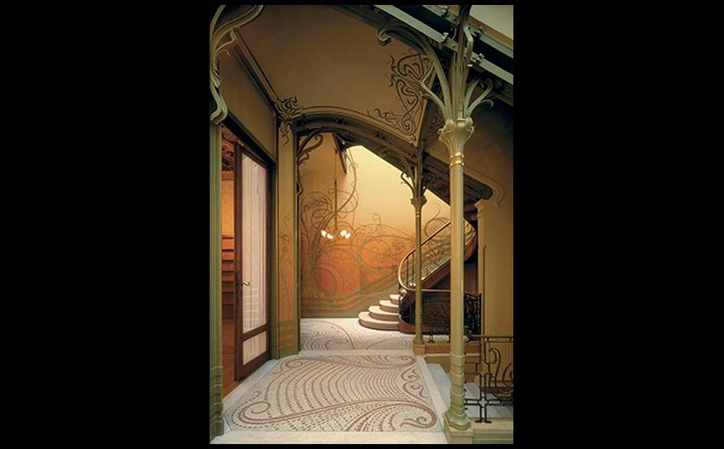
Victor Horta STAIRWAY, TASSEL HOUSE, BRUSSELS 1892–1893. © 2016 – Victor Horta, Bastin & Evrard/DACS, London.
Notes:
Victor Horta STAIRWAY, TASSEL HOUSE, BRUSSELS 1892–1893. © 2016 – Victor Horta, Bastin & Evrard/DACS, London.

Slide 36
Art Nouveau (3 of 5)
Gaudí
Before Horta's Tassel House, Antoní Gaudí was designing Art Nouveau buildings in Barcelona.
Casa Batlló draws on Islamic, Gothic, and Baroque traditions.
The façade is a dreamlike fantasy of sandstone sculpture and multicolor glass mosaic.
Its roof resembles a recumbent dragon.

Slide 37
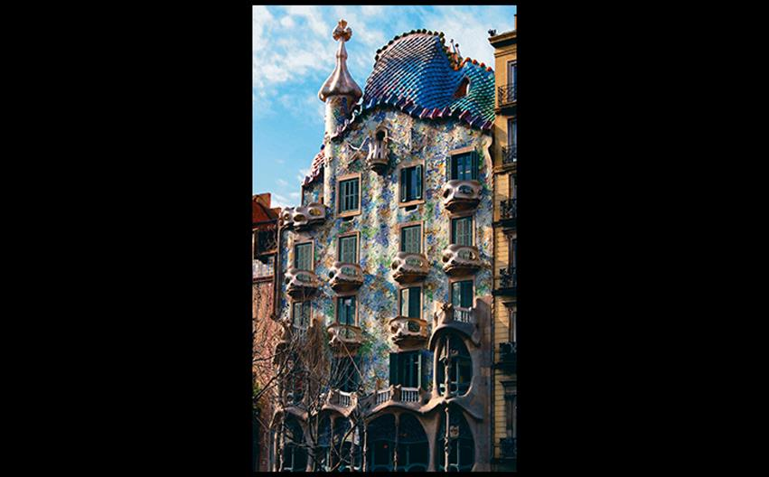
Antonio Gaudí CASA BATLLÒ, BARCELONA 43 Passeig de Gracia. 1900–1907. Vincent Abbey Photography.
Notes:
Antonio Gaudí CASA BATLLÒ, BARCELONA 43 Passeig de Gracia. 1900–1907. Vincent Abbey Photography.

Slide 38
Art Nouveau (4 of 5)
Guimard
Hector Guimard is best known for his designs of entrances to the Paris Métro.
Much of the rest of his career dealt with interior design and furnishings.
Desk is asymmetrical and organic.

Slide 39
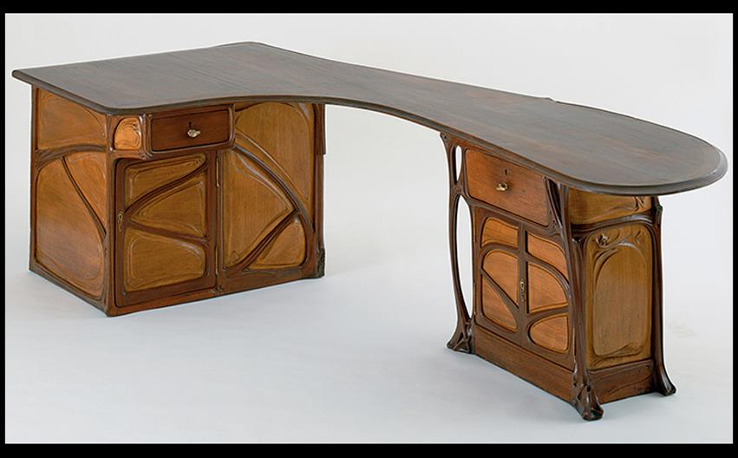
Hector Guimard DESK c. 1899 (remodeled after 1909). Olive wood with ash panels, 28-3/4" × 47-3/4" (73 × 121 cm). Museum of Modern Art, New York. Gift of Madame Hector Guimard. © 2016. Digital Image, The Museum of Modern Art/Scala, Florence/ Art Resource, NY.
Notes:
Hector Guimard DESK c. 1899 (remodeled after 1909). Olive wood with ash panels, 28-3/4" × 47-3/4" (73 × 121 cm). Museum of Modern Art, New York. Gift of Madame Hector Guimard. © 2016. Digital Image, The Museum of Modern Art/Scala, Florence/ Art Resource, NY.

Slide 40
Art Nouveau (5 of 5)
Toulouse-Lautrec
Henri de Toulouse-Lautrec chronicled life in Montmartre, capturing café dancer Jane Avril.
Emphasis on outline, tipped-up ground, and integration of blank paper reflect japonisme in addition to expressionism.

Slide 41
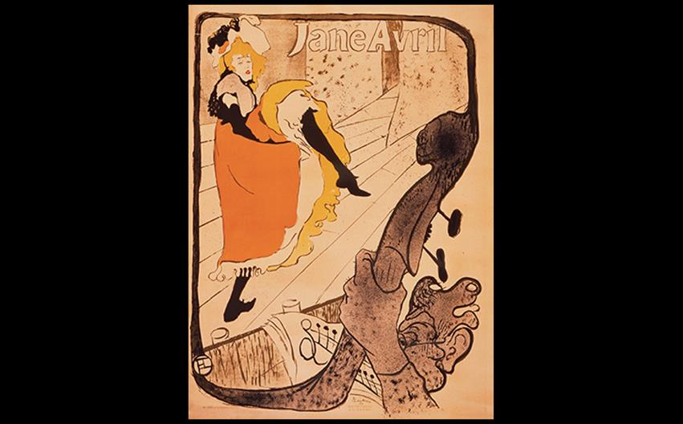
Henri de Toulouse-Lautrec JANE AVRIL 1893. Four color lithograph, 51-1/8" × 37/3/8" (129.85 × 94.93 cm). Los Angeles County Museum of Art, Los Angeles. Gift of Mr. and Mrs. Billy Wilder (59.80.15).
Notes:
Henri de Toulouse-Lautrec JANE AVRIL 1893. Four color lithograph, 51-1/8" × 37/3/8" (129.85 × 94.93 cm). Los Angeles County Museum of Art, Los Angeles. Gift of Mr. and Mrs. Billy Wilder (59.80.15).

Slide 42
The Beginnings of Modernism
At this time in history, the industrial industry was caught between the classical traditions of the Beaux-Arts style and the new aesthetic.
Cities like the industrialized Chicago demanded new ways of designing and creating tall buildings.

Slide 43
European Architecture: Technology and Structure (1 of 3)
A fast-paced life was born of the ability for people to manufacture more, consume more, and travel more.
There was a growing belief in the perfectibility of society that spawned international fairs celebrating innovations in industry and technology.
Britain asserted their right to empire at the Great Exhibition in 1851.

Slide 44
European Architecture: Technology and Structure (2 of 3)
The Crystal Palace
Created by Joseph Paxton, this structure consisted of an cast-iron skeleton holding the largest glass panes that could be mass-produced at the time.
The triple-tiered edifice covered over 18 acres, unsurprisingly the largest space ever enclosed up to that time.

Slide 45
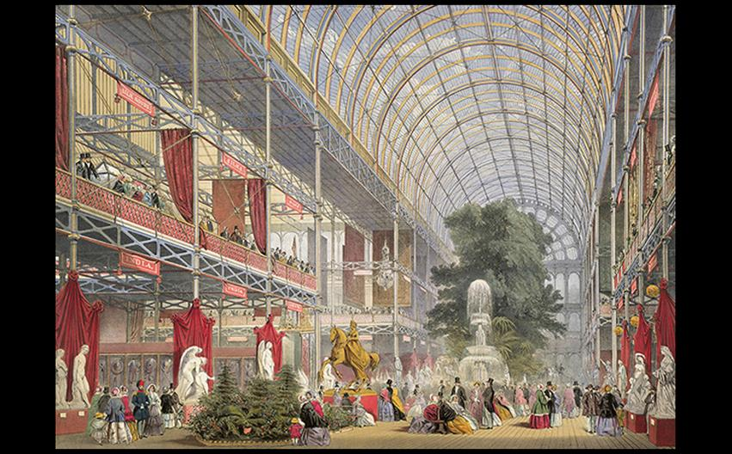
Joseph Paxton THE CRYSTAL PALACE London. 1850–1851. Iron, glass, and wood. (Print of the Great Exhibition of 1851; printed and published by Dickinson Brothers, London, 1854. Illustration by Joseph Nash and Robert Haghe). British Library, London.
Notes:
Joseph Paxton THE CRYSTAL PALACE London. 1850–1851. Iron, glass, and wood. (Print of the Great Exhibition of 1851; printed and published by Dickinson Brothers, London, 1854. Illustration by Joseph Nash and Robert Haghe). British Library, London.

Slide 46
European Architecture: Technology and Structure (3 of 3)
Bibliothèque Nationale
The Reading Room is an example of the fusion of the academy's historicizing married with technical advances in engineering.
Domes faced with white ceramic tiles sat atop thin iron arches and columns that opened up the space.

Slide 47
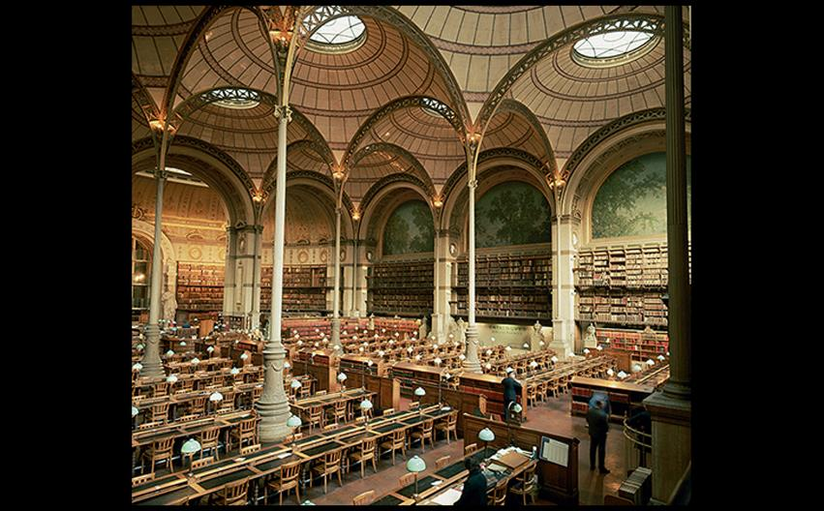
Henri Labrouste READING ROOM, BIBLIOTHÈQUE NATIONALE, PARIS 1862–1868. © Paul Almasy/Corbis.
Notes:
Henri Labrouste READING ROOM, BIBLIOTHÈQUE NATIONALE, PARIS 1862–1868. © Paul Almasy/Corbis.

Slide 48
The Chicago School (1 of 4)
The city of Chicago required spaces that would accommodate more people and activities in urban areas.
It became the center of a new way of thinking about urban design and construction.

Slide 49
The Chicago School (2 of 4)
World's Columbian Exposition
Richard Morris Hunt, an American, began with academy training and supervised the building of this Exposition in 1983.
The photograph shows this "White City" in its intended glory—a model city, clean and spacious with Classical planning, in contrast to the conditions found in most American cities.

Slide 50
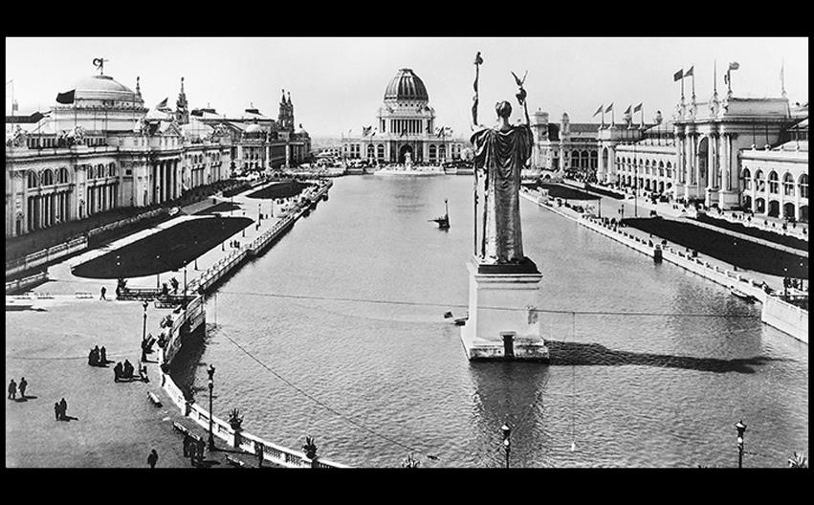
COURT OF HONOR, WORLD'S COLUMBIAN EXPOSITION, CHICAGO 1893. View from the east. © Corbis.
Notes:
COURT OF HONOR, WORLD'S COLUMBIAN EXPOSITION, CHICAGO 1893. View from the east. © Corbis.

Slide 51
The Chicago School (3 of 4)
Richardson
Henry Hobson Richardson created the style of Richardsonian Romanesque, seen in the Marshall Field Wholesale Store.
The rough stone facing, arched windows, and decorated cornice evoke architectural antecedents, but with a readily identifiable new style.

Slide 52
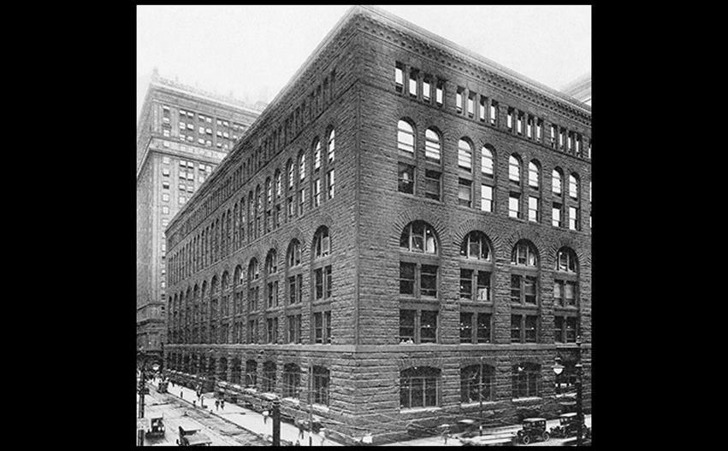
Henry Hobson Richardson MARSHALL FIELD WHOLESALE STORE, CHICAGO 1885–1887. Demolished c. 1935. Courtesy the Library of Congress.
Notes:
Henry Hobson Richardson MARSHALL FIELD WHOLESALE STORE, CHICAGO 1885–1887. Demolished c. 1935. Courtesy the Library of Congress.

Slide 53
The Chicago School (4 of 4)
Sullivan
An early example of the Chicago School style is the Wainwright Building in St. Louis, Missouri.
This building is taller than it is wide and is comprised of ten stories in three parts.
Such a tripartite structure suggests the lingering influence of Classical columns.
It illustrates the philosophy of "form follows function."

Slide 54
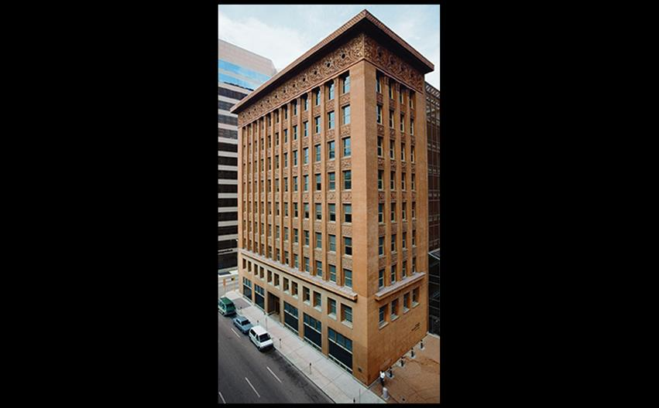
Louis Sullivan WAINWRIGHT BUILDING, ST. LOUIS Missouri. 1890–1891. © Art on File/Corbis.
Notes:
Louis Sullivan WAINWRIGHT BUILDING, ST. LOUIS Missouri. 1890–1891. © Art on File/Corbis.

Slide 55
The City Park
Crowding and pollution prompted the creation of large public parks between the 1830s–1860s.
Rapid growth of Manhattan caused civic leaders to set aside parkland while space existed.
The resulting Central Park was designed to be the opposite of rectangular and paved-in streets.

Slide 56
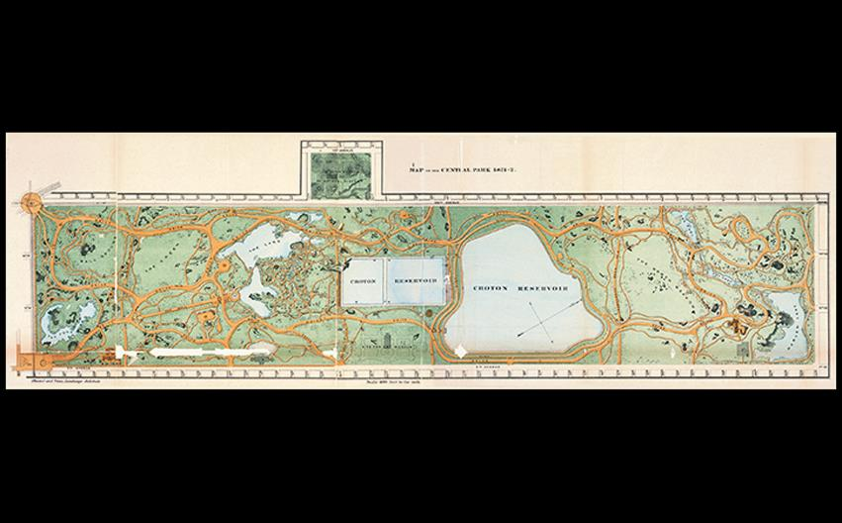
Frederick Law Olmsted and Calvert Vaux MAP OF CENTRAL PARK, NEW YORK CITY Revised and extended park layout as shown in a map of 1873. Frederick Law Olmsted & Calvert Vaux/City of New York, Department of Parks
Notes:
Frederick Law Olmsted and Calvert Vaux MAP OF CENTRAL PARK, NEW YORK CITY Revised and extended park layout as shown in a map of 1873. Frederick Law Olmsted & Calvert Vaux/City of New York, Department of Parks.

Slide 57
Cézanne (1 of 4)
Paul Cézanne (1839–1902) adopted a bright palette and loose brushwork to paint his landscapes in the 1870s.
These were highly structured and merged drawing and modeling into a single process.
His goal was to make Impressionism solid and durable, like the art of museums.

Slide 58
Cézanne (2 of 4)
Mont Sainte-Victoire shows a mountain rising above a valley dotted with houses and trees.
Its even lighting and absence of human activity create a sense of timelessness.
Brushstrokes vary from short cross-hatchings to broad swaths of flat color and are highly deliberate.

Slide 59
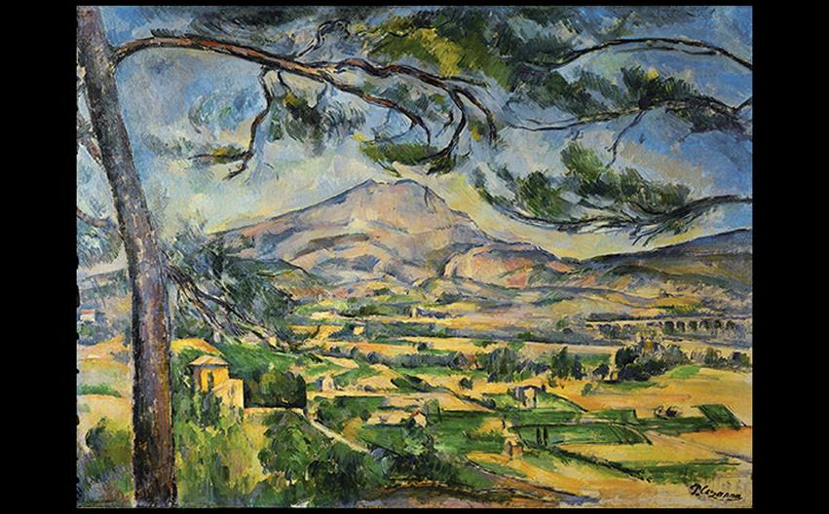
Paul Cézanne MONT SAINTE-VICTOIRE c. 1885–1887. Oil on canvas, 25-1/2" × 32" (64.8 × 92.3 cm). The Samuel Courtauld Trust, The Courtauld Gallery, London. (P.1934.SC.55). © Samuel Courtauld Trust, The Courtauld Gallery, London, UK/Bridgeman Images.
Notes:
Paul Cézanne MONT SAINTE-VICTOIRE c. 1885–1887. Oil on canvas, 25-1/2" × 32" (64.8 × 92.3 cm). The Samuel Courtauld Trust, The Courtauld Gallery, London. (P.1934.SC.55). © Samuel Courtauld Trust, The Courtauld Gallery, London, UK/Bridgeman Images.

Slide 60
Cézanne (3 of 4)
Still Life with Basket of Apples shows spatial ambiguities.
The right side of the basket is higher than the left and pastries are tilted up toward the viewer.
These shifting viewpoints are not the product of incompetence, but rather a rejection of scientific perspective in favor of positioning objects from multiple sightings.

Slide 61
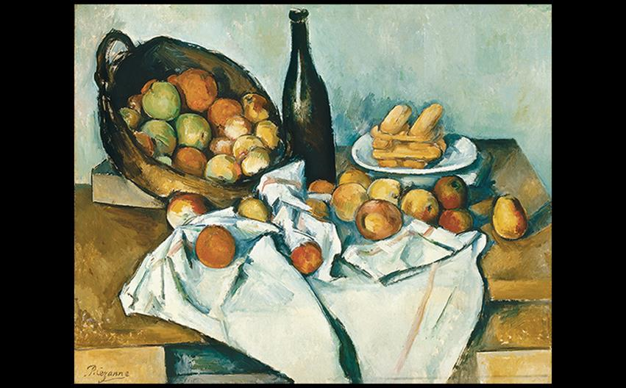
Paul Cézanne STILL LIFE WITH BASKET OF APPLES 1880–1894. Oil on canvas, 24-7/16" × 31-1/2" (64.8 × 80 cm). The Art Institute of Chicago. Helen Birch Bartlett Memorial Collection (1926.252). Photo © The Art Institute of Chicago.
Notes:
Paul Cézanne STILL LIFE WITH BASKET OF APPLES 1880–1894. Oil on canvas, 24-7/16" × 31-1/2" (64.8 × 80 cm). The Art Institute of Chicago. Helen Birch Bartlett Memorial Collection (1926.252). Photo © The Art Institute of Chicago.

Slide 62
Cézanne (4 of 4)
The Large Bathers, left unfinished at the end of the artist's life, was the largest canvas he ever painted.
In some ways it returns to certain conventions of history painting; for example, an Arcadian landscape suggesting a mythological theme.

Slide 63
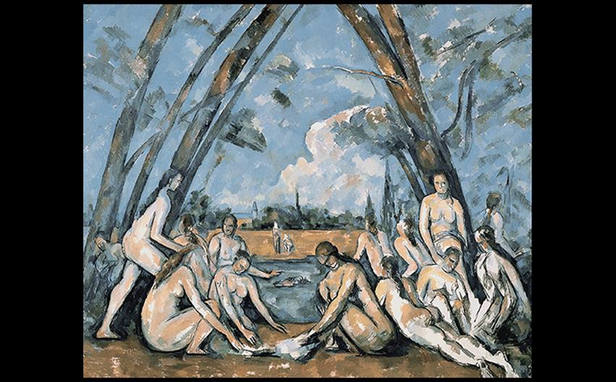
Paul Cézanne THE LARGE BATHERS 1906. Oil on canvas, 6'10" × 8'2" (2.08 × 2.49 m). Philadelphia Museum of Art. The W.P. Wilstach Collection. © 2016. Philadelphia Museum of Art/Art Resource, NY/Scala, Florence.
Notes:
Paul Cézanne THE LARGE BATHERS 1906. Oil on canvas, 6'10" × 8'2" (2.08 × 2.49 m). Philadelphia Museum of Art. The W.P. Wilstach Collection. © 2016. Philadelphia Museum of Art/Art Resource, NY/Scala, Florence.

Slide 64
Technique: The Photographic Process
A camera is basically a lightproof box with an aperture, lens, and a shutter.
When the shutter is open, light reflected off objects strikes the film and exposes it.
Light is directed through a negative onto paper to create a positive image.
Today's technology records photo images digitally.

Slide 65
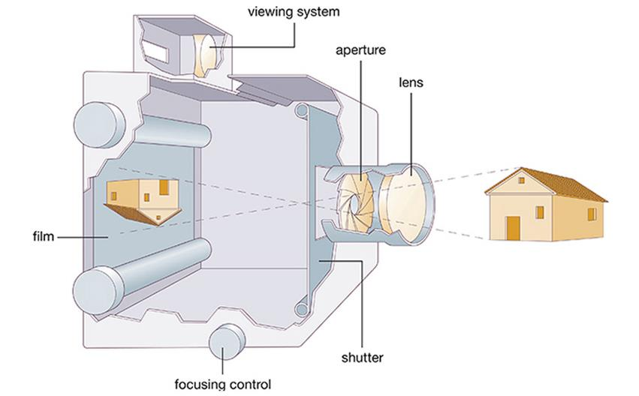
TECHNIQUE: The Photographic Process
Notes:
TECHNIQUE: The Photographic Process

Slide 66
Early Photography in Europe and the United States (1 of 4)
The camera obscura was an early device for recording images from life.
Photography was developed as a way to make permanent visual impressions.
Louis-Jacques-Mandé Daguerre was the first to "fix" a photographic image.
A silver-coated metal plate treated with iodine fumes could make images visible when treated with mercury vapor.

Slide 67
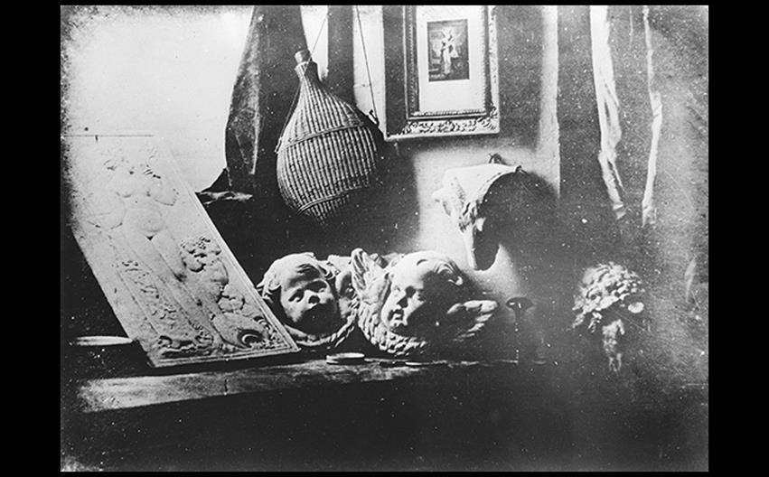
Louis-Jacques-Mandé Daguerre THE ARTIST'S STUDIO 1837. Daguerreotype, 6-1/2" × 8-1/2" (16.5 × 21.6 cm). Société Française de Photographie, Paris. © akg-images.
Notes:
Louis-Jacques-Mandé Daguerre THE ARTIST'S STUDIO 1837. Daguerreotype, 6-1/2" × 8-1/2" (16.5 × 21.6 cm). Société Française de Photographie, Paris. © akg-images.

Slide 68
Early Photography in Europe and the United States (2 of 4)
Daguerrotypes include a still life of plaster casts and a framed drawing that stakes a claim for photography as art.
Samuel Morse, inventor of the telegraph, introduced the daguerrotype to America within weeks of Daguerre's announcement.
He reduced exposure times short enough to take portrait photographs.

Slide 69
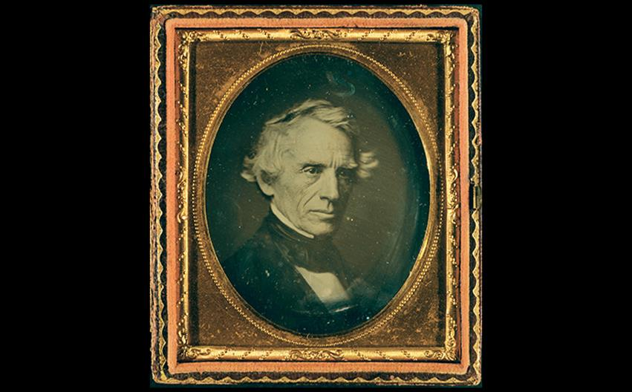
DAGUERREOTYPE OF SAMUEL FINLEY BREESE MORSE c. 1845. Sixth plate daguerreotype, 2-3/4" × 3-1/4" (7 × 8.3 cm). The Daguerreotype Collection of the Library of Congress, Washington, DC. Courtesy the Library of Congress.
Notes:
DAGUERREOTYPE OF SAMUEL FINLEY BREESE MORSE c. 1845. Sixth plate daguerreotype, 2-3/4" × 3-1/4" (7 × 8.3 cm). The Daguerreotype Collection of the Library of Congress, Washington, DC. Courtesy the Library of Congress.

Slide 70
Early Photography in Europe and the United States (3 of 4)
William Henry Fox Talbot worked on his own calotype independently from Daguerre, making positive prints from negatives, from which an unlimited number of prints could be made.

Slide 71
Early Photography in Europe and the United States (4 of 4)
Talbot published a book in six parts, The Pencil of Nature, which included The Open Door.
It is a picture evoking an agrarian way of life that was fast disappearing.
Frederick Scott Archer found that silver nitrate would adhere to glass if mixed with collodion, resulting in a glass negative with greater tonal subtlety.

Slide 72
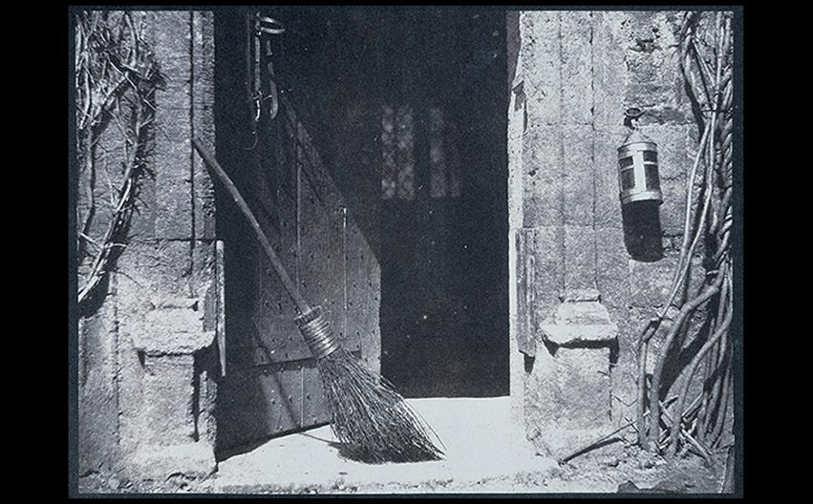
Henry Fox Talbot THE OPEN DOOR 1843. Salt-paper print from a calotype negative, 5-5/8" × 7-11/16" (14.3 × 19.5 cm). Science Museum, London. Fox Talbot Collection. © National Media Museum/Science & Society Picture Library.
Notes:
Henry Fox Talbot THE OPEN DOOR 1843. Salt-paper print from a calotype negative, 5-5/8" × 7-11/16" (14.3 × 19.5 cm). Science Museum, London. Fox Talbot Collection. © National Media Museum/Science & Society Picture Library.

Slide 73
Alexander Gardner and Julia Margaret Cameron (1 of 2)
Alexander Gardner sought to show a Rebel Sharpshooter killed in battle, but the image was not organically taken from the Battle of Gettysburg.
The photographers dragged the dead body to the site and posed it, exhibiting the difficult reality that photography does not equate to factuality.

Slide 74
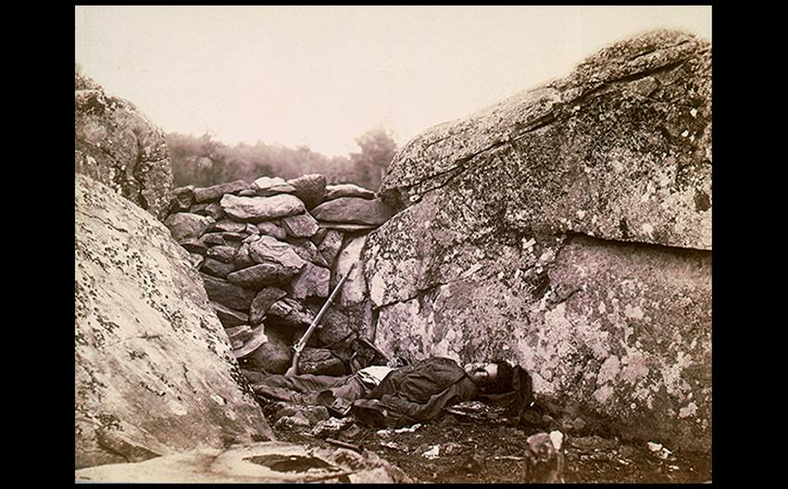
Alexander Gardner THE HOME OF THE REBEL SHARPSHOOTER: BATTLEFIELD AT GETTYSBURG 1863. Albumen print, 7" × 9" (18 × 23 cm). Library of Congress, Washington, DC. Courtesy the Library of Congress
Notes:
Alexander Gardner THE HOME OF THE REBEL SHARPSHOOTER: BATTLEFIELD AT GETTYSBURG 1863. Albumen print, 7" × 9" (18 × 23 cm). Library of Congress, Washington, DC. Courtesy the Library of Congress

Slide 75
Alexander Gardner and Julia Margaret Cameron (2 of 2)
Julia Margaret Cameron began photographing at age 49 and created purposely out-of-focus portraits of great British men.
Thomas Carlyle calls attention to light that suffused the subject in a metaphor for creative genius.

Slide 76
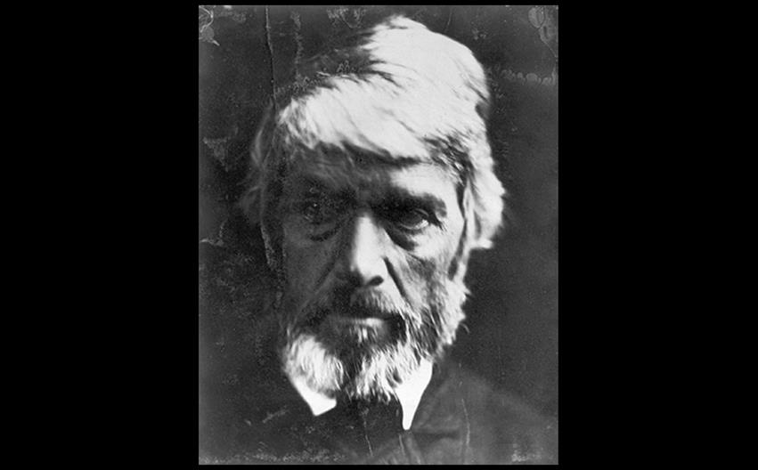
Julia Margaret Cameron PORTRAIT OF THOMAS CARLYLE 1867. Silver print, 10" × 8" (25.4 × 20.3 cm). The Royal Photographic Society, Collection at National Museum of Photography, Film, and Television, England. © National Media Museum/Science & Society Picture Library
Notes:
Julia Margaret Cameron PORTRAIT OF THOMAS CARLYLE 1867. Silver print, 10" × 8" (25.4 × 20.3 cm). The Royal Photographic Society, Collection at National Museum of Photography, Film, and Television, England.

